Slide 1
Dependency injection in .net
Ianuarie 2017

Slide 2
agenda
What is dependency injection
Di Container
DI catalog
DI patterns
DI anti-patterns
DI refactoring
Object composition
Object lifetime
Unity
MEF

Slide 3
agenda
What is dependency injection
Di Container
DI catalog
DI patterns
DI anti-patterns
DI refactoring
Object composition
Object lifetime
Unity
MEF

Slide 4
What is dependency injection
Dependency Injection is a set of software design principles and patterns that enable us to develop loosely coupled code.

Slide 5
What is dependency injection
When you go and get things out of the refrigerator for yourself, you can cause problems. You might leave the door open, you might get something Mommy or Daddy doesn’t want you to have.
You might even be looking for something we don’t even have or which has expired.
What you should be doing is stating a need, “I need something to drink with lunch,” and then we will make sure you have something when you sit down to eat.
What this means in terms of object-oriented software development is this: collaborating classes (the five-year-olds) should rely on the infrastructure (the parents) to provide the necessary services.
John Munsch et al., “How to explain Dependency Injection to a 5-year old,” 2009, http://stackoverflow.com/questions/1638919/how-to-explain-dependency-injection-to-a-5-year-old

Slide 6
What is dependency injection
Basic purpose of DI: maintainability.

Slide 7
What is dependency injection
Basic purpose of DI: maintainability.
One of many ways to make code maintainable is through
loose coupling.

Slide 8
What is dependency injection
Basic purpose of DI: maintainability.
One of many ways to make code maintainable is through
loose coupling. Loose coupling makes code extensible, and
extensibility makes it maintainable.

Slide 9
What is dependency injection
Basic purpose of DI: maintainability.
One of many ways to make code maintainable is through
loose coupling. Loose coupling makes code extensible, and
extensibility makes it maintainable.
DI is nothing more than a technique that enables loose coupling.

Slide 10
DI – doing it wrong
Exercise: Mary has to build a simple list of featured products, pulled from a database table and displayed on a web page; an example is shown in figure 2.3. If the user viewing the list is a preferred customer, the price on all products should be discounted by five percent.

Slide 11
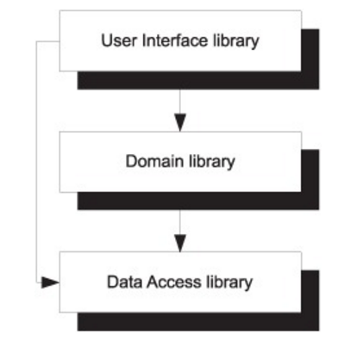
DI – doing it wrong
Mary's approach:
create a project with 3 layers: DAL, BSS/DLL, UI
- DAL uses EF and it contains the context for Product entity
- BSS/DLL refers DAL and exposes a Service that returns
Product entity from DAL
- UI refers BSS and returns the result.

Slide 12
Practice
Example: Lesson1

Slide 13
DI – doing it wrong
Mary's approach:
create a project with 3 layers: DAL, BSS/DLL, UI
- DAL uses EntityFramework and it contains the context for Product entity
- BSS/DLL refers DAL and exposes a Service that returns Product entity from DAL
- UI refers BSS and returns the result.
First issues with this approach:
DAL must be referred in BSS and UI also
Entity domain model is exposed in UI
A web.config file should be added only in the UI but it’s needed
Also in DLL
- What happens if we need change

Slide 14
DI – doing it wrong
Possible future scenarios:
If Mary’s application becomes a success, the project’s stakeholders would like her to develop a rich client version in Windows Presentation Foundation (WPF). Is this possible to do while reusing the Domain Layer and the Data Access Layer?

Slide 15
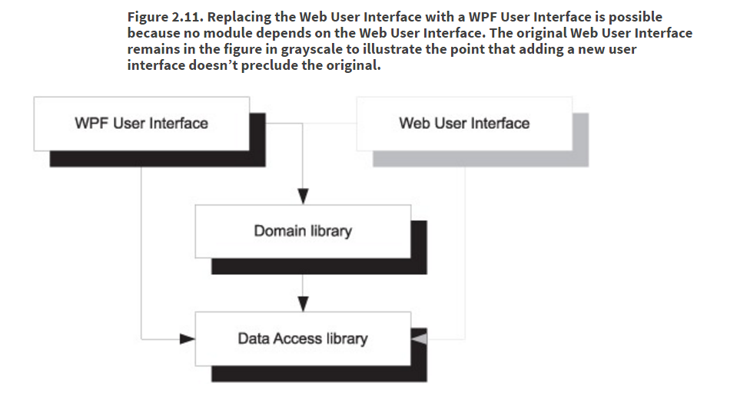
DI – doing it wrong
Possible future scenarios:
If Mary’s application becomes a success, the project’s stakeholders would like her to develop a rich client version in Windows Presentation Foundation (WPF). Is this possible to do while reusing the Domain Layer and the Data Access Layer?

Slide 16
DI – doing it wrong
Possible future scenarios:
Imagine that market analysts figure out that, to optimize profits, Mary’s application should be available as a cloud application hosted on Windows Azure. In Windows Azure, data can be stored in the highly scalable Azure Table Storage Service. This storage mechanism is based on flexible data containers that contain unconstrained data. The service enforces no particular database schema, and there’s no referential integrity. The protocol used to communicate with the Table Storage Service is HTTP, and the most obvious data access technology on .NET is based on ADO.NET Data Services. This type of database is sometimes known as a key-value database, and it’s a different beast than a relational database accessed through the Entity Framework.

Slide 17
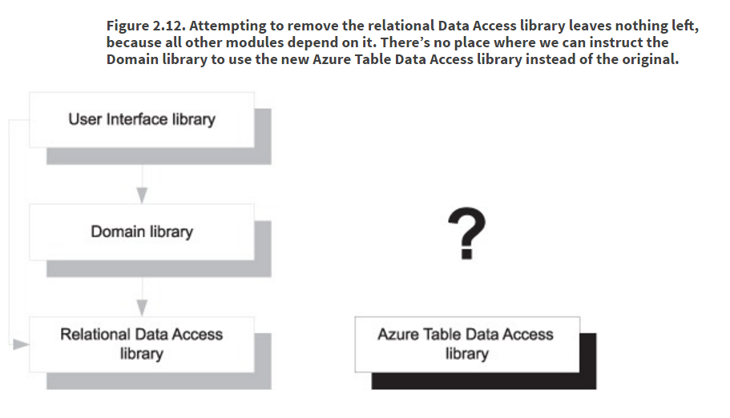
DI – doing it wrong
Possible future scenarios:
To enable the e-commerce application as a cloud application, the Data Access library must be replaced with a module that uses the Table Storage Service. Is this possible?

Slide 18
DI – doing it wrong
Possible future scenarios:
To enable the e-commerce application as a cloud application, the Data Access library must be replaced with a module that uses the Table Storage Service. Is this possible?
We already know that both User Interface and Domain libraries depend on the Entity Framework-based Data Access library. If we try to remove the Data Access library, the solution will no longer compile, because a required DEPENDENCY is missing.

Slide 19
DI – doing it right
Some Simple Concepts:
POCO term is used to identify an object as a simple object as opposed to the complicated, specialized
objects that frameworks like ORM systems usually generat (wiki)
DTO or data transfer object is an object that carries data between processes. They are simple object that should not contain business logic.

Slide 20
DI – doing it right
Some Simple Concepts:
Repository pattern
The repository mediates between the data source layer and the business layers of the application. It queries the data source for the data, maps the data from the data source to a business entity, and persists changes in the business entity to the data source. A repository separates the business logic from the interactions with the underlying data source or Web service. The separation between the data and business tiers has three benefits:
It centralizes the data logic or Web service access logic.
It provides a substitution point for the unit tests.
It provides a flexible architecture that can be adapted as the overall design of the application evolves.

Slide 21
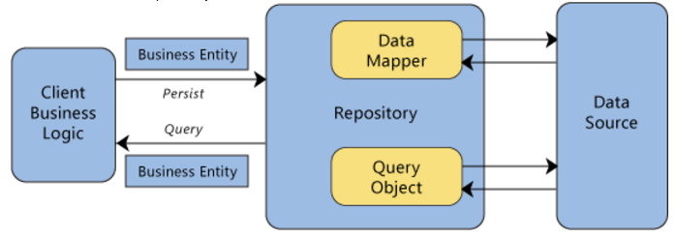
DI – doing it right
Some Simple Concepts:
Repository pattern

Slide 22
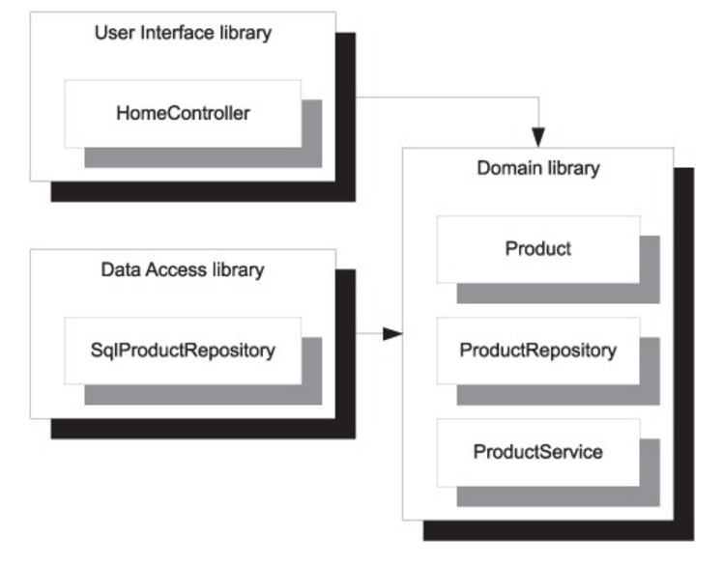
DI – doing it right

Slide 23
Practice
Example: Lesson2

Slide 24
DI – doing it right
Can we replace the relational Data Access library with one that works with the Azure Table Service? In chapter 3 I’ll describe how the application locates and instantiates the correct ProductRepository, so for now take the following at face value: the Data Access library is being loaded by late binding, and the type name is defined as an application setting in web.config. It’s possible to throw the current Data Access library away and inject a new one, as long as it also provides an implementation of ProductRepository.

Slide 25
CompaRe both solutions
WRONG | WRIGHT

Slide 26
agenda
What is dependency injection
Di Container
DI catalog
DI patterns
DI anti-patterns
DI refactoring
Object composition
Object lifetime
Unity
MEF

Slide 27
Di containers
DI is first and foremost a technique, but you can use technology to make things easier. We call this technology DI CONTAINERS.
A DI CONTAINER is a library that provides DI functionality.

Slide 28
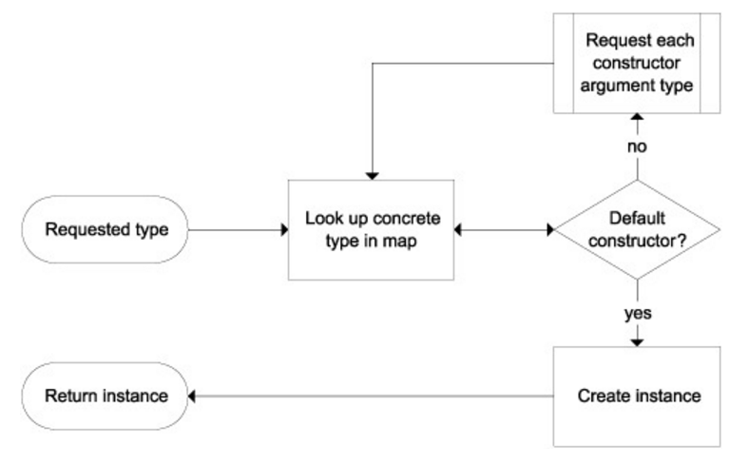
Di containers
AUTO-WIRING is the ability to automatically compose an object graph from maps
between ABSTRACTIONS and concrete types.

Slide 29
Di containers
Example: Auto-wiring a BasketController
BasketController constructor used:
public BasketController(IBasketService basketService)
When a DI CONTAINER receives a request for a BasketController, the first thing it will do is look up the type in its configuration. BasketController is a concrete class, so it maps to itself. The container then uses Reflection to inspect BasketController’s constructor.
Because this constructor isn’t a default constructor, we need to repeat the process for the IBasketService constructor argument.
The container looks up IBasketService in its configuration and finds that it maps to the concrete BasketService class. The single public constructor for BasketService has this signature:
public BasketService(BasketRepository repository, BasketDiscountPolicy discountPolicy)
That’s still not a default constructor, and now you have two constructor arguments to deal with. The container takes care of each in order so it starts with the abstract BasketRepository class that, according to the configuration, maps to SqlBasketRepository. SqlBasketRepository has a public constructor with this signature:
public SqlBasketRepository(string connString)
The single constructor argument is a string parameter with the name connString which is configured to have a particular value. Now that the container has the appropriate value, it can invoke the SqlBasketRepository constructor. It has now successfully handled the repository parameter for the BasketService constructor.

Slide 30
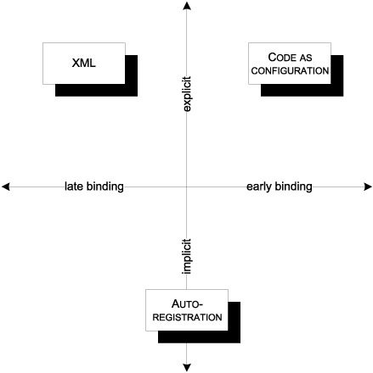
Di containers - Configuration
The most common ways to configure a DI CONTAINER shown against dimensions of explicitness and the degree of binding

Slide 31
Di containers - Configuration
Style | Description | Advantages | Disadvantages
XML | Configuration settings (often in .config files) specify the mappings. | Supports replacement without recompilation High degree of control | No compile-time checks Verbose
CODE AS CONFIGURATION | Code explicitly determines mappings. | Compile-time checks High degree of control | No support for replacement without recompilation
AUTO-REGISTRATION | Rules are used to locate suitable components and build the mappings. | Supports replacement without recompilation Less effort required Helps enforce conventions to make a code base more consistent | Partial compile-time checks Less control

Slide 32
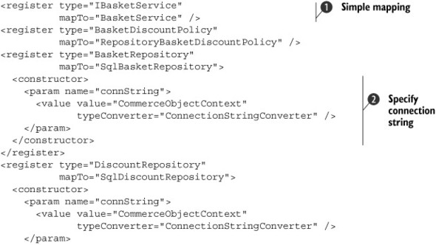
Di containers - Configuration
Configuring Unity with XML

Slide 33
Di containers - Configuration
Configuring Unity with XML

Slide 34
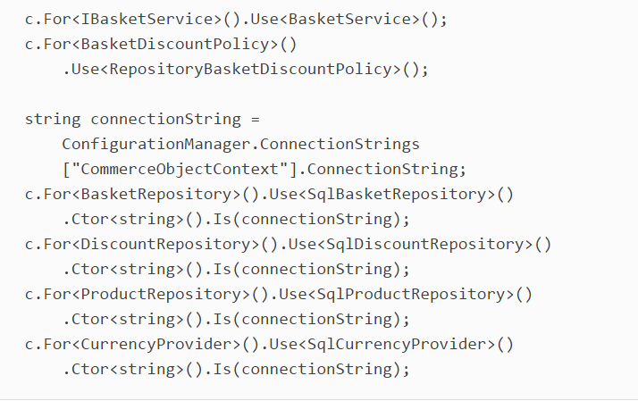
Di containers - Configuration
Configuring StructureMap with code

Slide 35
Bibliografie
https://www.safaribooksonline.com/library/view/dependency-injection-in/9781935182504/kindle_split_013.html

